Slide 1
STPV Meeting
February 17, 2017
Nari Jeon

Slide 2
Move forward to better temperature stability
Materials | M.P [˚C] | Softening [˚C] | n @ 632 nm
W | 3422 | 2281 | 3.6
Al2O3 | 2072 | 1381 | 1.77
TiO2 | 1830 | 1220 | 2.58
SiO2 | 1600 | 1067 | 1.46
Materials | Possible oxides and m.p
W | W2O3 (?), WO2 (1700˚C), WO3(1473˚C), W2O5 (?)
Mo | MoO2 (1100˚C), MoO3 (795˚C)
Ta | Ta2O5 (1872˚C)
Nb | NbO (1940˚C), NbO2 (1915˚C), Nb2O5(1512˚C)
Oxygen chemical potentials can be used to compare different propensities to the formation of metal oxides at high temperatures.

Slide 3
ALD possibility
Materials | n | m.p | Precursors | T | G | Precursor price
Ta |  |  | TDMAT, plasma H
Mo | 3.7 (3.6 W) |  | MoF6, Si2H6 |  |  | $1996/200g ($1335/225g W)
MgO | 1.74 | 2852 | Bis(cyclopentadienyl)magnesium at 100 | 80-350 | 1.2
HfO2 | 2.11 | 2758 | tetrakis ethylmethylamino hafnium, O3 or H2O | 160-420 | 0.7 | $931/25mL
ZrO2 | 2.21 | 2715 | ZrCl4, [(CH3)2N]4Zr, H2O bubbler | 280-400 | 1-5 | $262.5/100g
CeO2 | 2.36 | 2600 | Ce(thd)4, O3 | 300 | 0.3
CaO | 1.83 | 2570 |  |  | 0.2
BeO | 1.72 | 2530 | Dimethylberyllium, H2O | 250
Cr2O3 | 2.5 | 2435 |  |  | 1
SrO | 1.87 | 2430 | Sr(C5Me5)2 and Sr(C5Me4Pr)2, H2O | 350 | 3
Y2O3 | 1.93 | 2410 | tris(cyclopentadienyl)yttrium | 150-280 | 1.6 | $125.5/g
13Å thick WOx interfacial layer between W/ZrO2
http://dx.doi.org/10.1063/1.1569985

Slide 4
Refractory nitrides and oxides
REOx
BN
ZrN
TiN
NbN
GaN
AlN
MgO
HfO2
ZrO2
CeO2
CaO
BeO
SrO
ZnO
TiO2
SiO2
Cr2O3
Y2O3
Al2O3
Ta2O5
Nb2O5

Slide 5
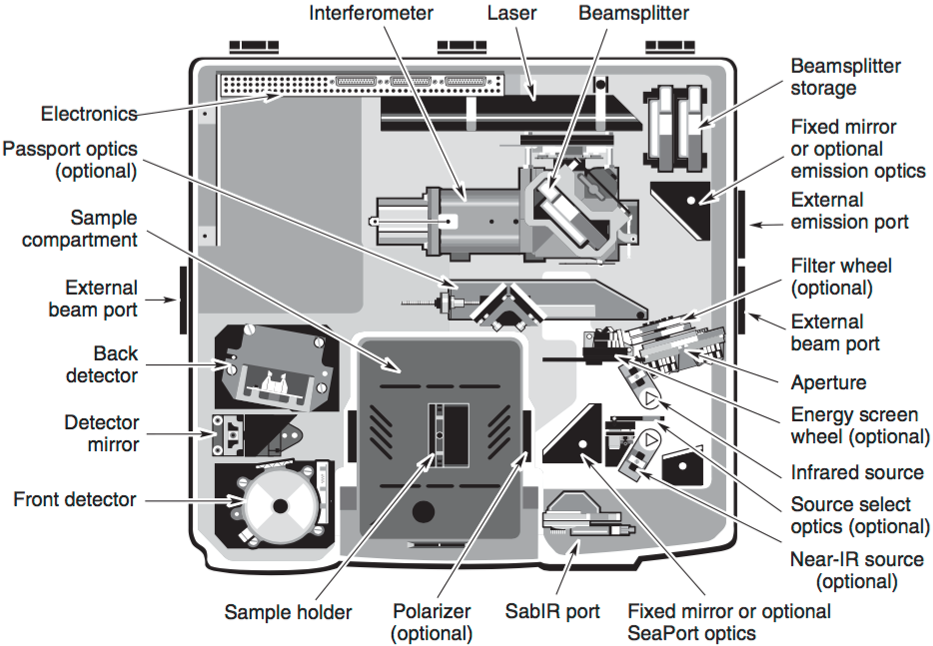
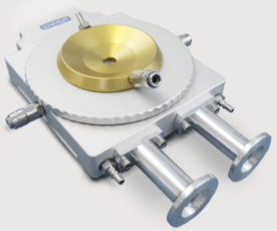
Nicolet 6700 with Linkam stage
TS1500
Sample cup 7mm diameter, 2.5/6 mm dip
200 ˚C/min
CaF2 window / MCT
854.70 nm - 8,333.33nm

Slide 6
Plan
Reflectivity, n, k measurement of Bragg reflectors
Test growth of W-Al2O3 on BR (Si, W substrates)
Screening of working temperatures: 1000, 1100, 1200, 1300, 1400˚C
High temperature emissivity measurement

